Slide 1
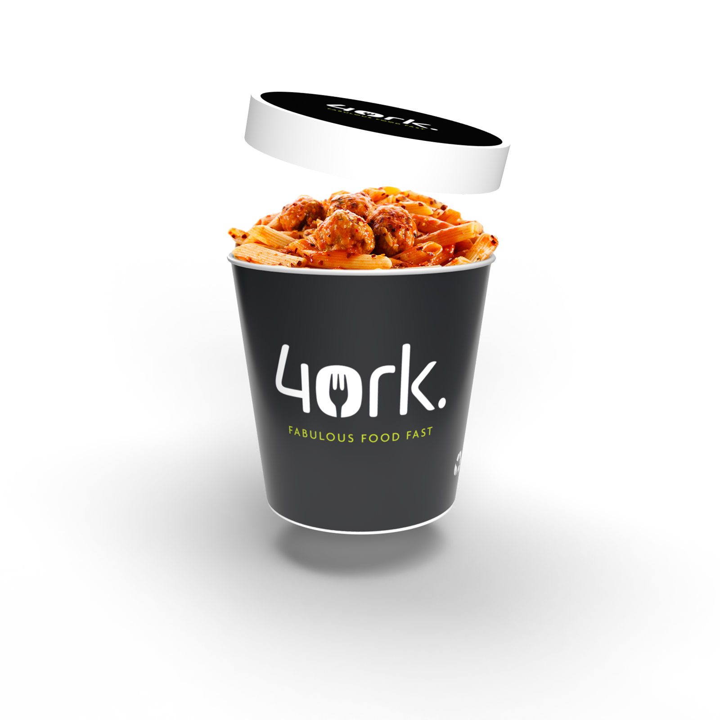




MEAL DEALS
Grab & Go Meal Deal
Selected Boxed Sandwich, Small Water & Fruit
£2.70
Main Course Meal Deal
Traditional Main Meal, Veggie Option, Pasta or Jacket Potato
Served with a Homemade Biscuit or Selected Drink
£2.70

