Slide 1
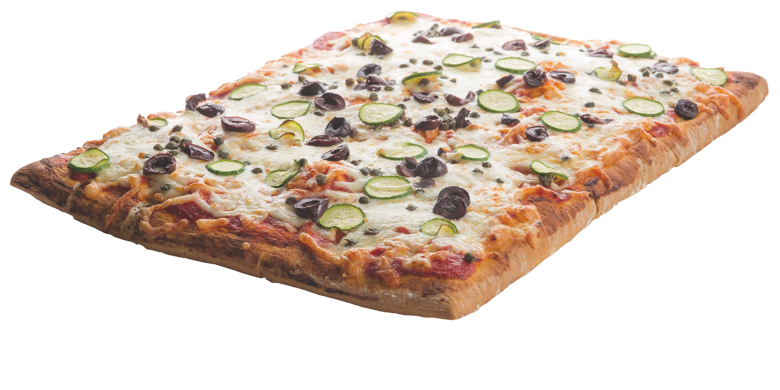


MID MORNING BREAK
Sausage Rolls - £1.20
Bacon or Sausage Sandwich - £1.65
Hash Brown Pot - £1.40
Veggie Sausage Sandwich - £1.65
Focaccia Pizza Slice - £0.95
Belgian Waffles - £1.35
Danish Pastries - £1.00
Sandwiches & Salads - From £2.00
Fruit,Yoghurt & Granola Pots - £1.35
Fresh Fruit - From £0.50
Selection of Drinks - From £0.65
Breakfast Muffin - £1.65

