Slide 1
TRY SOMETHING NEW CHARITY DAY 2026
DONATIONS TO MAGGIE'S CANCER SUPPORT CHARITY
ON WEDNESDAY 15 JULY YOU WILL BE ABLE TO TAKE PART IN FUN ACTIVITIES DURING THE SCHOOL DAY INSTEAD OF GOING TO NORMAL LESSONS!!! THIS IS A CHARITY EVENT WITH ALL DONATIONS GOING TO MAGGIE’S NEWCASTLE CANCER SUPPORT CHARITY.
A DONATION OF £1 PER CHOICE FOR UP TO 2 DIFFERENT ACTIVITIES DURING THE DAY.
ACTIVITIES WILL GO LIVE ON THE SCHOOL GATEWAY ON WEDNESDAY 8TH JULY. YOU WILL BE ABLE TO SIGN UP AND GIVE YOUR DONATIONS. EACH ACTIVITY WILL HAVE A MAXIMUM NUMBER OF PLACES AND THEY WILL BE ALLOCATED ON A FIRST COME BASIS.
FOR EXAMPLE: LESSON 1; JUGGLING WORKSHOP; F9; MQU; 10 PLACES

Slide 2
LESSON 1
STAFF | ROOM/SPACE | ACTIVITY | NUMBER
GGI | SCHOOL FIELD | SOFTBALL | 18
AMB | Library | Board Games (Year 8 Only) | 20
KBO | F25 | Write and illustrate your own poetry | 10
JPA | F23 | Mario Kart | 8
CEG | S12 | Learn to speak Thai | 16
CLI | G13 | Making a friendship bracelet or a hair wrap with embroidery thread. | 15
HBR/PWR | F3 | Panto workshop (Must be confident to perform in front of the rest of the group) | 15
ABO | Library | Grafitti Art | 16

Slide 3
LESSON 2
STAFF | ROOM/SPACE | ACTIVITY | NUMBER
NCA | F21 | Board games- some will be provided, you can also bring your own! | 30
AMB | Library | Chess (Must be able to play) Mini Competitions | 16
HJO/ABN | Sports hall | Y7 mat race (teams of 4 compete to move a mat by jumping on it! Can you be the quickest team?! | 24
ABO | Library | Grafitti Art | 16
SRo | F22 | Creative Writing- create a collaborative piece of creative writing | 10
JBR | F11 | Y7 Lego Masters - Lego bulding challenges | 10

Slide 4
LESSON 3
STAFF | ROOM/SPACE | ACTIVITY | NUMBER
AMB/KPO | Library | The "Post-Apocalyptic" Bridge (Lego challenge) - Year 7 and 8 only | 12
CBM | F2 | Pub Quiz | 25
PNE/NTU/AYA | G19 | Taskmaster | 15
SSY/KWN | Sports hall | Y8 mat race (teams of 4 compete to move a mat by jumping on it! Can you be the quickest team?! | 24
CDO/PCO | School field | Golf - test yourself against the par 3 golf course set up outside. | 20
ABO | Library | Grafitti Art | 16
CEM | outside (meet dining street) | KUBB- Viking lawn game. | 12

Slide 5
LESSON 4
STAFF | ROOM/SPACE | ACTIVITY | NUMBER
KWI & TLO | G11 | Quick Pizza making, all year groups welcome. | 11
HHa & SSt | F7 | Eat cake, and colour in (cake, colouring sheets and pens/pencils provided) | 15
MWA | G1 | Rocket Building | 15
ABN | F5.6 | An introduction to British Sign Language
KMU | G14 | fashion illustration | 16
ATA | G9 | Badge making (25mm pin badges) | 16
ATH | S11 | Origami | 15
CDO/PCO | School field | Golf - test yourself against the par 3 golf course set up outside. | 20

Slide 6
LESSON 5
STAFF | ROOM/SPACE | ACTIVITY | NUMBER
GGI | SCHOOL FIELD / 4G | 5v5 Football - mixed Y7, 8 & 9 Teams | 40
AMB | Library | Board Games (Year 7 Only) | 20
SCA | S8 | Task Master | 20
MWA | G1 | Rocket Building | 15
PJO/JMR | Sports hall | Y9 mat race (teams of 4 compete to move a mat by jumping on it! Can you be the quickest team?! | 24
CTI | Dining street piano side | Make a floral book vase | 10
HWA/TLO | G12 | Quick pizza making | 11

Slide 7
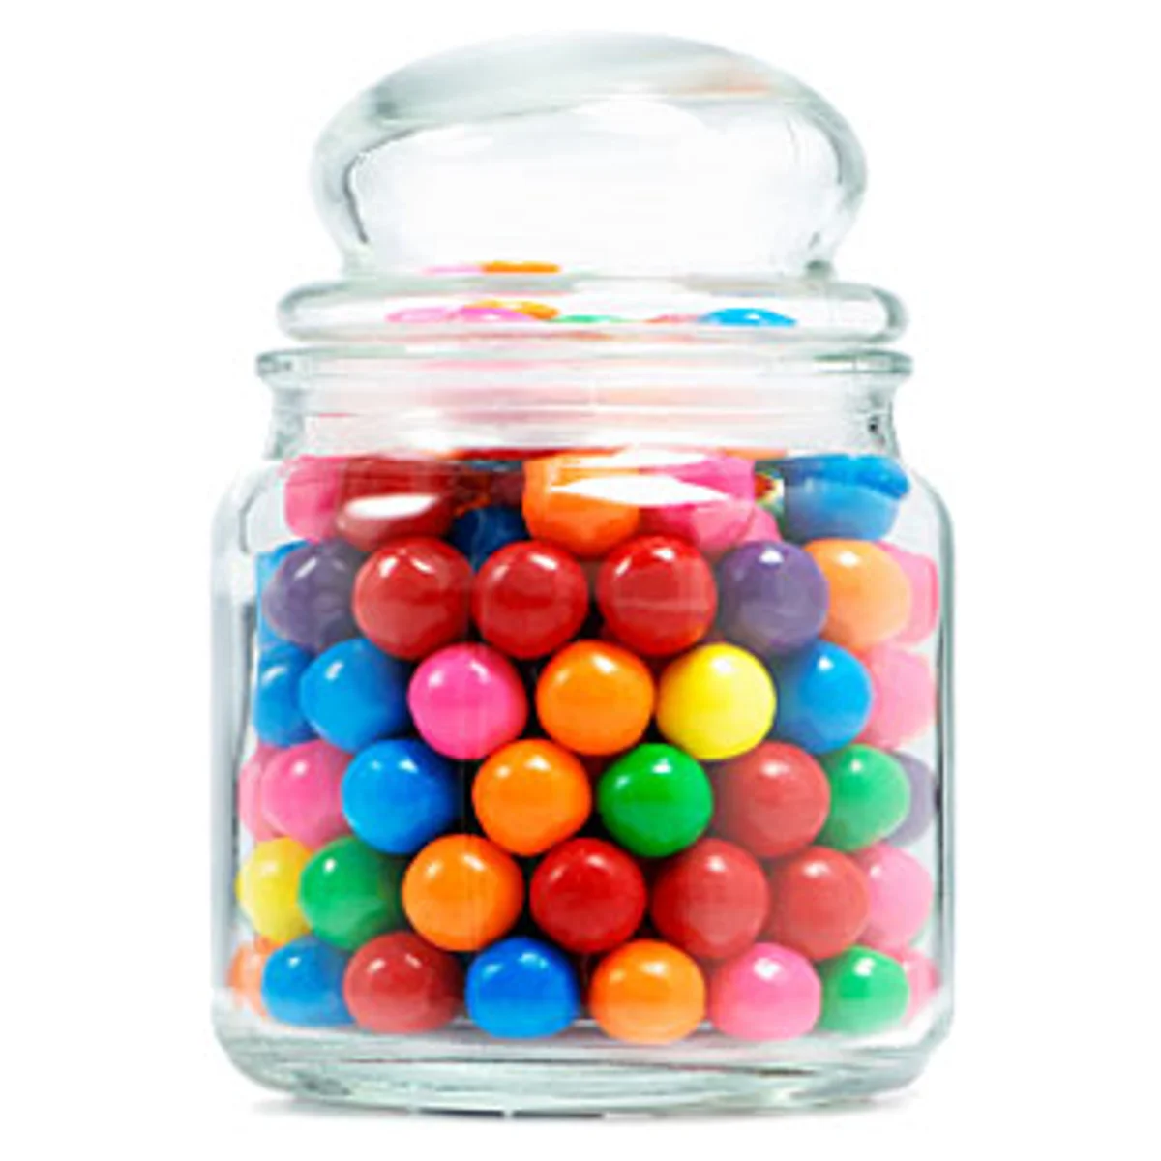



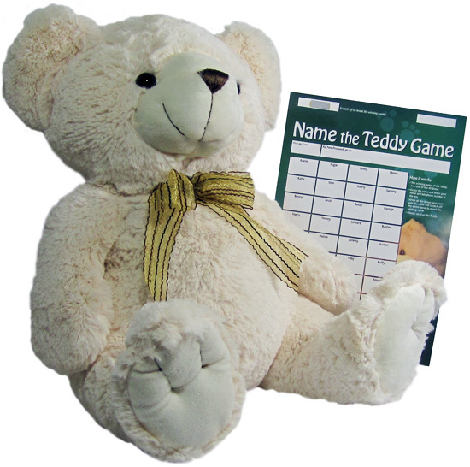



FAIRGROUND FETE
CHARITY EVENT
On the last day of term, our Year 12 students are going to be running a variety of fairground style stalls in each year group social area.
PLEASE BRING SOME SPARE CHANGE WITH YOU!
All the proceeds will go to Maggie’s.
When? Friday 18 July, break time
Where? Every year group social area

